Slide 1
Purpura Hemorrhagica

Slide 2
Is a hemorrhagic disease of horses associated with leukocyte-clastic vasculitis.
The majority of cases occur as sequelae to strangles. However, Cases also occur following immunization against S. equi and as sequelae to infection with other streptococci. *The disease appears to be an immune-complex mediated disease with deposition of IgA containing immune complexes on vessel walls.

Slide 3
Hemorrhagic tendencies in the disease include petechial and ecchymotic hemorrhages but also can result in large extravasations of blood and serum into tissues.
The hemorrhage and exudation of serum can cause anemia and a reduced circulating blood volume.
The severity of clinical signs seen with purpura varies from a mild, transient reaction to a severe, fatal disease.

Slide 4
The typical clinical signs seen as a result of the vasculitis include
subcutaneous edema, most frequently involving the head, limbs, and/or trunk,
petechiation and ecchymoses of the mucous membranes.
Severe edema may result in oozing from the skin surfaces,
sloughing of the skin may occur.
In some cases, the vasculitis may affect other sites such as the gastrointestinal tract, lungs, and muscle, resulting in signs such as colic, respiratory difficulties, and muscle soreness.

Slide 5
Leukocyto-clastic vasculitis on histologic exam. of skin is consistent with a diagnosis of purpura hemorrhagica.
In those cases associated with S equi, isolation of the organism and demonstration of elevated IgA and IgG titers to S equi are also supportive

Slide 6
Treatment …..
1-Corticosteroids are the primary treatment for purpura. Generally, dexamethasone at 0.1–0.2 mg/kg
2- penicillin 20 000- 25 000 IU/ kg BW daily for 5 – 7 days
3- Nonsteroidal anti-inflammatory drugs
4-Supportive care, including intravenous fluids, and bandaging may also be indicated.

Slide 7
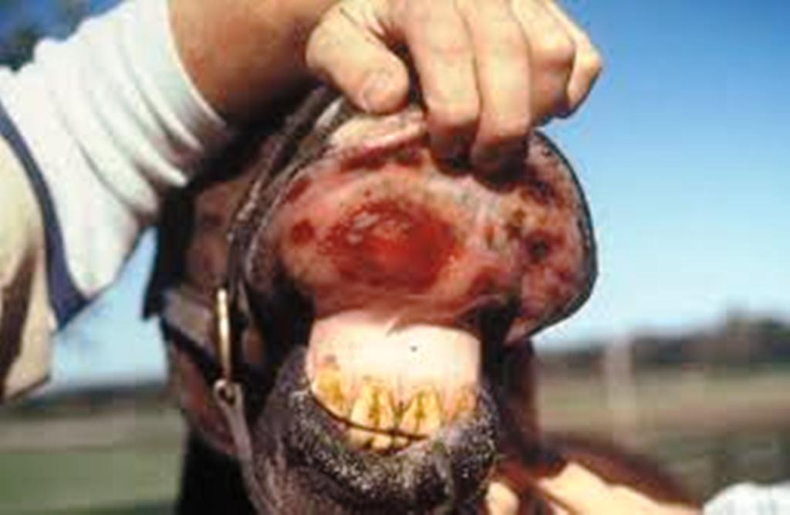

Slide 8
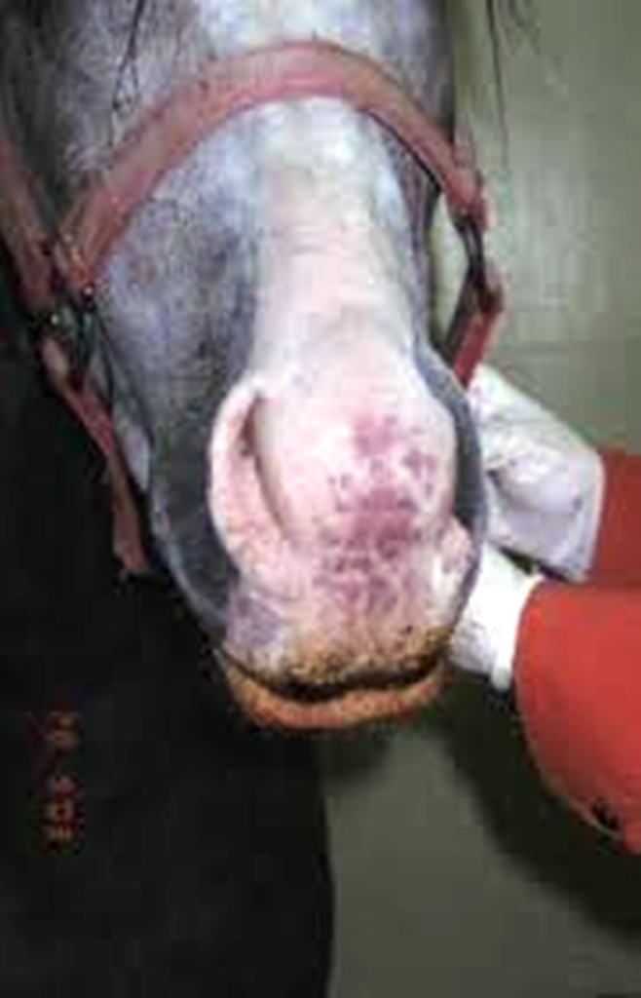

Slide 9
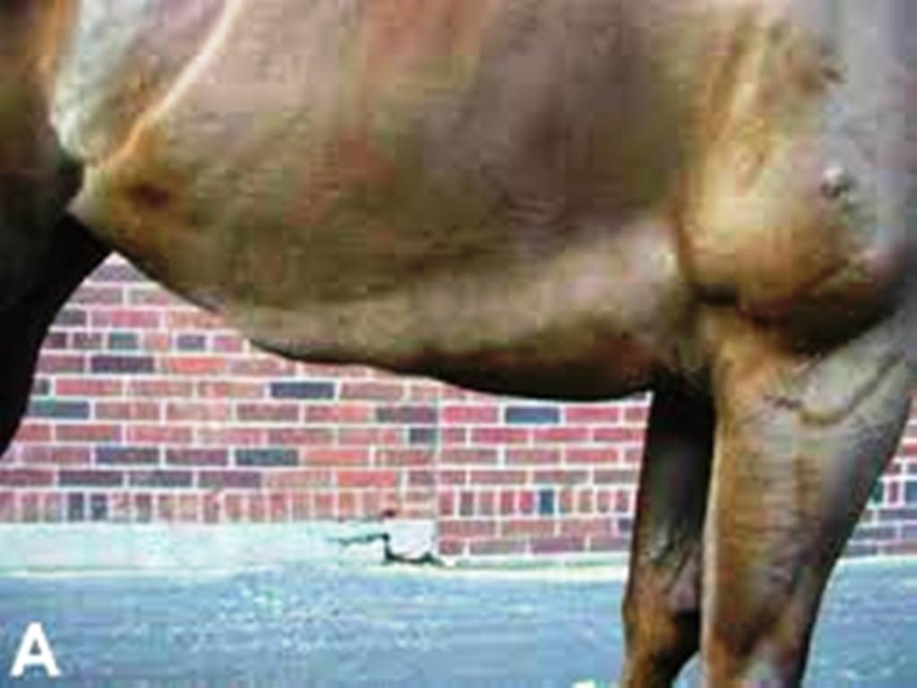

Slide 10
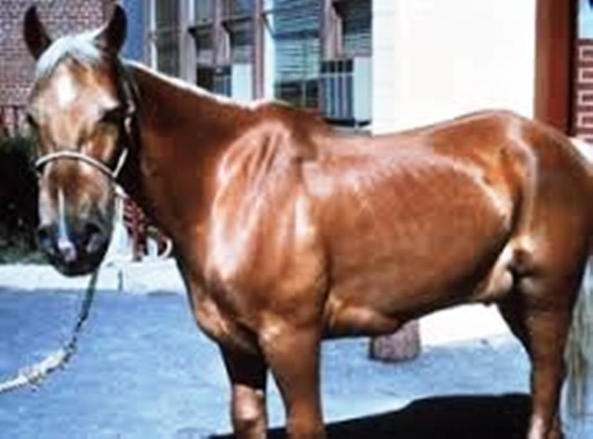

Slide 11
Chédiak–Higashi syndrome in cattle.
Aprolonged bleeding time is demonstrable despite the presence of normal soluble coagulation factors and platelet numbers, and it is a result of a defect in platelet aggregation.
Thrombasthenia (means weak platelets. Glanzmann thrombasthenia (GT) is one of several inherited disorders of platelet function, which also include Bernard-Soulier syndrome, as well as deficiencies of platelet adhesion, aggregation, and secretion.), and manifests with epistaxis in cold weather, subcutaneous hematomas, and prolonged bleeding following minor procedures such as vaccination and ear-tagging. Platelet dysfunction and purpura were diagnosed in a 5-day-old Simmental heifer.

Slide 12
Umbilical bleeding in calves
Has also been reported as an inherited condition in Japanese black cattle with low adenosine diphosphate (ADP)-induced platelet aggregation. Affected cattle die by 1 year of age from repeated umbilical cord hemorrhage.
Glanzmann’s disease
is reported in horses with a prolonged history of epistaxis not associated with exercise. The horses had prolonged bleeding time, markedly delayed clot retraction, and a decrease in concentration of fibrinogen receptors on the platelet surface.

